Slide 1
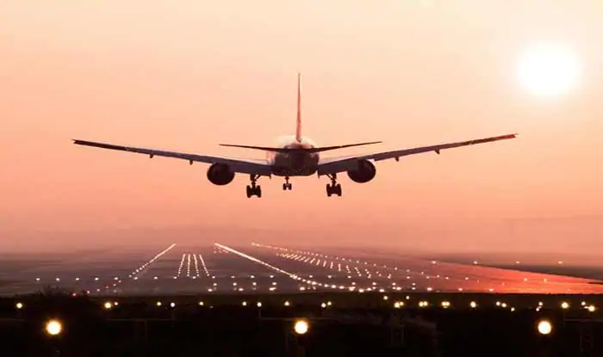
AIRLINES RESERVATION SYSTEM SOFTWARE ENGINEERING PROJECT
Submitted by:
Amit Srivastav( RA1911003010633)
Roshan Singh( RA1911003010636)
Aman Kalla( RA1911003010640)

Slide 2
MOTIVATION FOR THE PROJECT
Our motivation for choosing an airline reservation system was to develop a system that was visually appealing and easy to use.
Our motivation for the project was the eagerness to learn about web development
To enhance our coding skills and also to grab the technical know-how about the entire process of airline reservation system is what motivated us the most to undertake this project.

Slide 3
OBJECTIVE OF OUR PROJECT
The Aim of our project is to design and develop a software which would automate the major airline operations.
It would be providing the facilities for the reservation of online air tickets or any other operations through an effective and yet simple GUI for a normal passenger intending to travel through airways.

Slide 4
PROPOSED RESERVATION SYSTEM
Flight Booking System: The system allows the airline passenger to search for flights that are available between the two travel cities, namely the “Departure city” and “Arrival city” for a particular departure date. The system gives the list of available flights with certain flight details and allows customer to choose a particular flight suiting his comforts. If the seats are available in a particular flight, then the system allows the passenger to book a seat of his/her choice. Otherwise it asks the user to choose another flight. He can also cancel the current reservations without any problem.
Flight Status System: Our system allows the registered users to check the flight status if there is any delay in their flight timings due to inclement weather or any other reason. It automatically notifies by sending a message to the authorised passengers who have their tickets booked

Slide 5
PROPOSED RESERVATION SYSTEM (continued…)
User Accounts System: Creating and maintaining an online account on the system, in order to see status and updates on booked flights. A User can login into his account by providing its authorised username and password and alternatively a new user can register into the system and hence become an authorised user
Web Check-In: Passengers can get their boarding pass in advance through web check in and go straight to the baggage drop-counter. This will surely save their time. After all the necessary details needed for reservation are provided by the passenger, the screen then takes the traveller to confirm details and online pay the payment by online transaction screen.

Slide 6
ADVANTAGES OF THE PROPOSED SYSTEM
Results are received very quickly.
It uses concept of user friendliness.
Increases security, speed, storing and accuracy.
Customer services can not only be satisfied but also enhanced to the extent that one can obtain or cancel a reservation from anywhere.
Managing and maintaining data becomes easier.
Provide convenience to travellers.

Slide 7
BUSINESS TEMPLATE FOR THE PROJECT
Aim:
To Frame a project team, analyze and identify a Software project
Team Members:
Sl No | Register No | Name | Role
1 | RA1911003010633 | Amit Srivastav | Lead
2 | RA1911003010636 | Roshan Singh | Member
3 | RA1911003010640 | Aman Kalla | Member

Slide 8
Project Description
This software has two parts.
First is user part and the second is administrator part.
User part is used as a front end and administrator is the back end.
Administrator is used by airline authority. It allows the customers to access database and allow new customers to sign up for online access.
The system allows the airline passenger to search for flights that are available between the two travel cities, namely the “Departure city” and “Arrival city” for a particular departure and arrival dates.
The system displays all the flight’s details such as flight no, name, price and duration of journey etc.

Slide 9
Project Description
After search the system display list of available flights and allows customer to choose a particular flight. Then the system checks for the availability of seats on the flight. If the seats are available then the system allows the passenger to book a seat. Otherwise it asks the user to choose another flight.
To book a flight the system asks the customer to enter his details such as name, address, city, state, and credit card number and contact number. Then it checks the validity of card and book the flight and update the airline database and user database.
The system also allows the customer to cancel his/her reservation, if any problem occurs.
Result:
Thus, the project team formed and the project is described.

Slide 10
BUSINESS TEMPLATE FOR THE PROJECT(Continuation….)
THE PROJECT:
The project is aimed at exposing the relevance and importance of Airline Reservation Systems(ARS).
It is projected towards enhancing the relationship between customers and airline agencies through the use of ARSs, and thereby making it convenient for the customers to book the flights as when they require such that they can utilize this software to make reservations.
The main purpose of this software is to reduce the manual errors involved in the airline reservation process and make it convenient for the customers to book the flights as when they require such that they can utilize this software to make reservations, modify reservations or cancel a particular reservation.

Slide 11
BUSINESS TEMPLATE FOR THE PROJECT(Continuation….)
THE HISTORY:
In few countries, if a person wants to book a flight ticket, the following disadvantages are as follows:
Manually goes to the airport and book the ticket.
Downloading the ticket as paper document and filling it manually and submitting it at airport.
Fill the ticket form as paper documents.
Even if the ticket was reserved online, the freedom of approach/choice of the passenger has not much freedom.
Cannot upload and download the latest updates.
Less Security.
Less user-friendly.

Slide 12
BUSINESS TEMPLATE FOR THE PROJECT(Continuation….)
LIMITATIONS:
This software does not provide the customers with details of cost of the ticket and it does not allow the customer to modify a particular part of his reservation and he/she can modify all his details.
There must be a 64 MB on board memory.
APPROACH:
To provide the front end of a website is the part that users interact with. In order to have a better user interaction the approach used to develop the front end are HTML, CSS and JavaScript.
A back end developer is responsible for server-side web application, which is accomplished using software such as Java and Node.js.
The text editor apps used are atom text editor and VS code.

Slide 13
BUSINESS TEMPLATE FOR THE PROJECT(Continuation….)
BENEFITS:
This system provides a facility to easy access towards a customer and a real time user. They can be easily connected through it in just 3 steps.
There is no requirement for any type of Agent.
24/7 booking available for customers.
Increase the number of loyal customers.
Provides security to the customer database.
RESULT:
Thus the business case was prepared and the problem statement was arrived.

Slide 14
IDENTIFICATION OF PROJECT METHODOLOGY AND STAKEHOLDER DESCRIPTION TEMPLATE

Slide 15
Executive Summary
The model implemented for this project is Incremental Model.
Incremental Model is a process of software development where requirements divided into multiple standalone modules of the software development cycle. Our project employs three module:
Registration module- Passenger details are accepted and if the user exist then the passenger login to his/her account and if he is a new user, then his/her registration is done.
Administrator module- Keeping a track of the available seats in the flight, timing and fare of the flight and cancel the ticket on passenger request.
Passenger module- Viewing all the available flights and fare and timing details of the flight, booking the ticket and cancelling the ticket.

Slide 16
Executive Summary (continuation)
For the Identification of stakeholder, the answer lies in discovering and then aligning our project requirements with the communicated and non-communicated derived requirements (i.e., needs and expectations) of all parties interested in our project.
The stakeholder for our project includes the passenger who travel via flights, the owner responsible for allocating and managing resources, the developer team, sponsors who sponsor food and resort to the airline company, the cabin-crew members and the staff and support team.

Slide 17
Selection of Methodology
Since the project aims at developing models which would be tested after each phase and every time something new will be added hence the projects implements the methodology followed in incremental process model.
The incremental model for our project releases the home page with login and account creation details, followed by the second increment with the inclusion of the administrator module and followed by the third increment with the addition of passenger module.

Slide 18
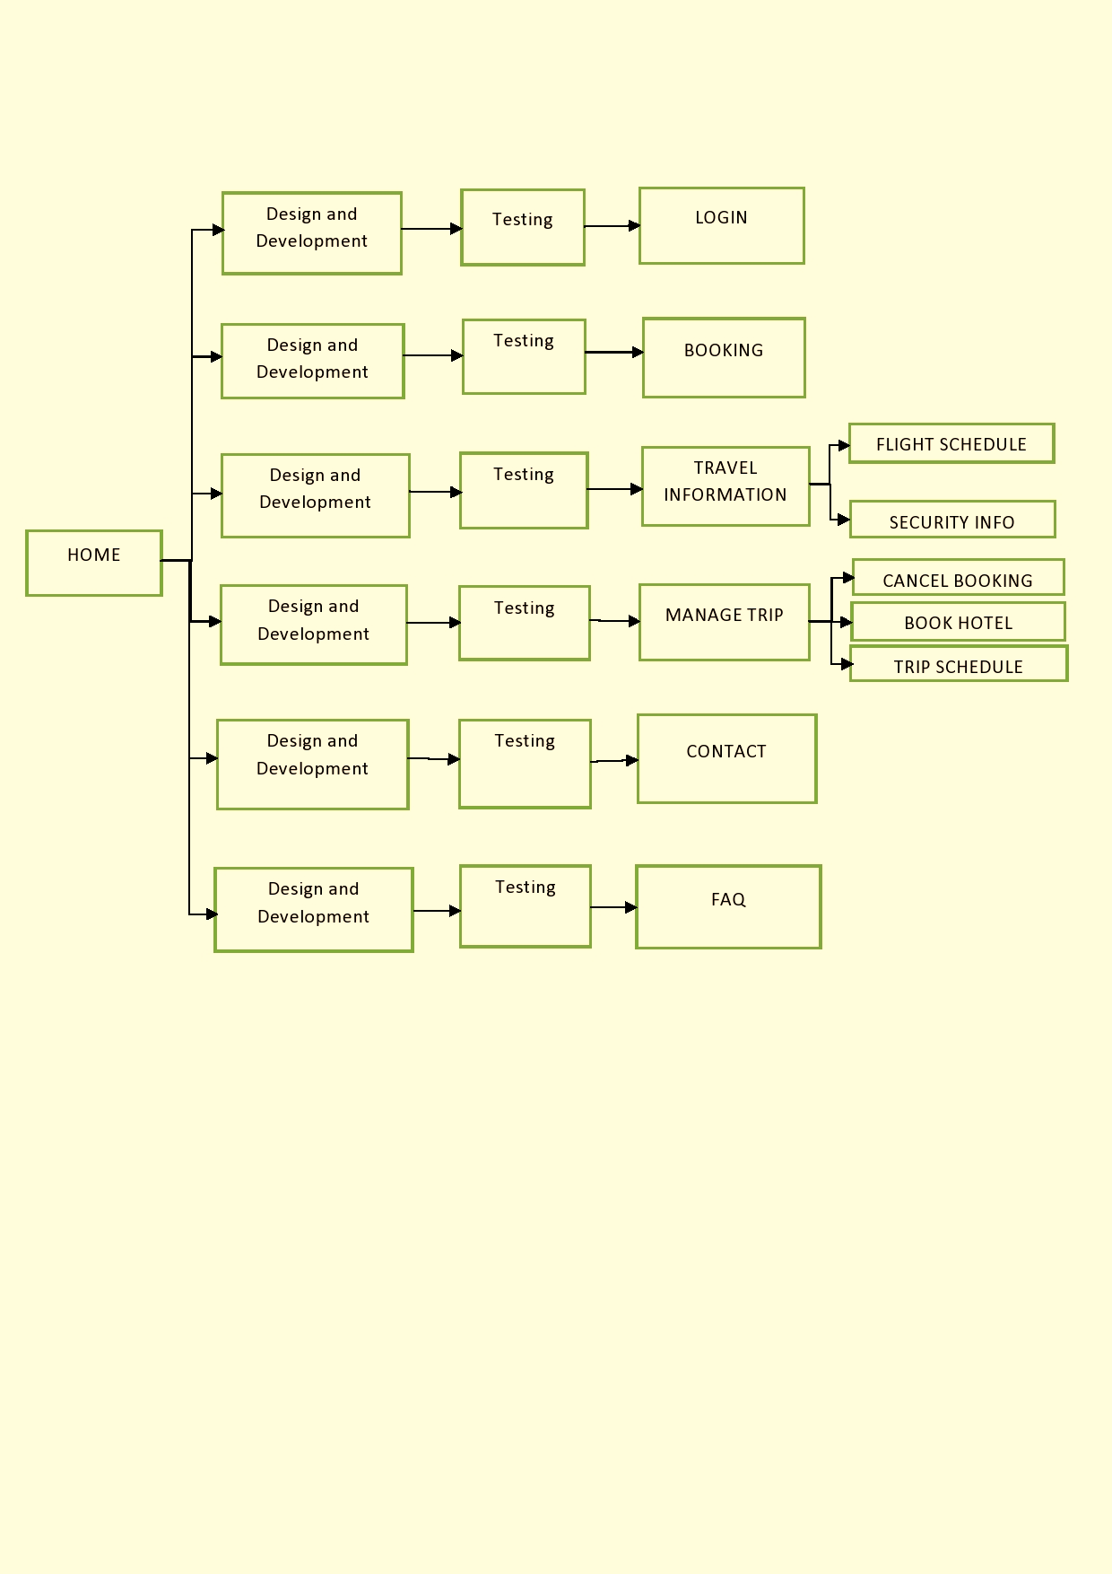
Outline of the incremental model used in the project

Slide 19
Selection of Methodology (Continuation)
Moreover the given below benefits of Incremental model led to the selection of this methodology:
Generates working software quickly and early during the software life cycle.
More flexible – less costly to change scope and requirements.
Easier to test and debug during a smaller iteration.
Easier to manage risk because risky pieces are identified and handled during its iteration.
Each iteration is an easily managed milestone.

Slide 20
Roles and Methods
End users : The end user for our project are the passenger who travel via flight.
Principals : Principal for our project are the principal consultant and co-founder of Indigo.
Partners : This includes operations staff, support staff and cabin-crew members.
Insiders : These are members of the development team and the leader along with the sponsor team which sponsor Sarovar hotel and Resort

Slide 21
Stakeholder Management

Slide 22
Identification of Stakeholders
Stakeholder identification is the process used to identify all stakeholders for a project.
It is important to understand that not all stakeholders will have the same influence or effect on a project, nor will they be affected in the same manner.
The stakeholders for our projects include:
Owner - Provides all the resources, but don’t appear to have specific requirements.
Sponsor (Sarovar Hotel &Resort) – Promoting the airlines to help the airlines generate sales.

Slide 23
Identification of Stakeholders (Continuation)
Team Members - Appear to be happy with new processes and system equipment.
Passenger - These are the people whose satisfaction matters the most for a successful project.
Cabin-crew - These are the people whose feedback after interaction with the passenger brings new scope for advancement and betterment of the project.
Support-Staff - Technical assistance and providing travel information to the passengers

Slide 24
Interest and Influence matrix
Interest | Influence
High | High
Low | High
High | Low
Low | Low
Low Interest, High Influence Keep them satisfied as they can be ‘defenders’ Help them engage more | High Interest, High Influence Engage them closely as they are key ‘drivers’
Low Interest, Low Influence Low Priority as they are ‘spectators’ | High Interest, Low Influence Keep them informed as they can be ‘blockers’

Slide 25
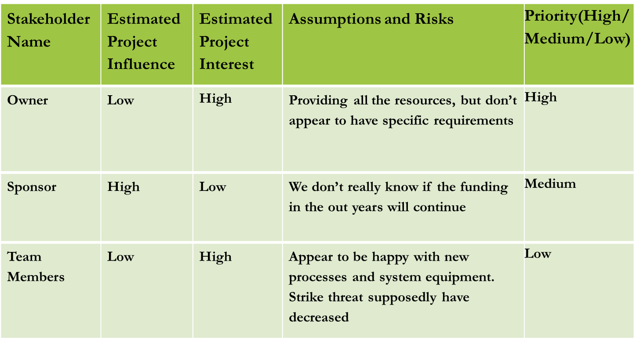
Interest and Influence matrix (continuation)

Slide 26
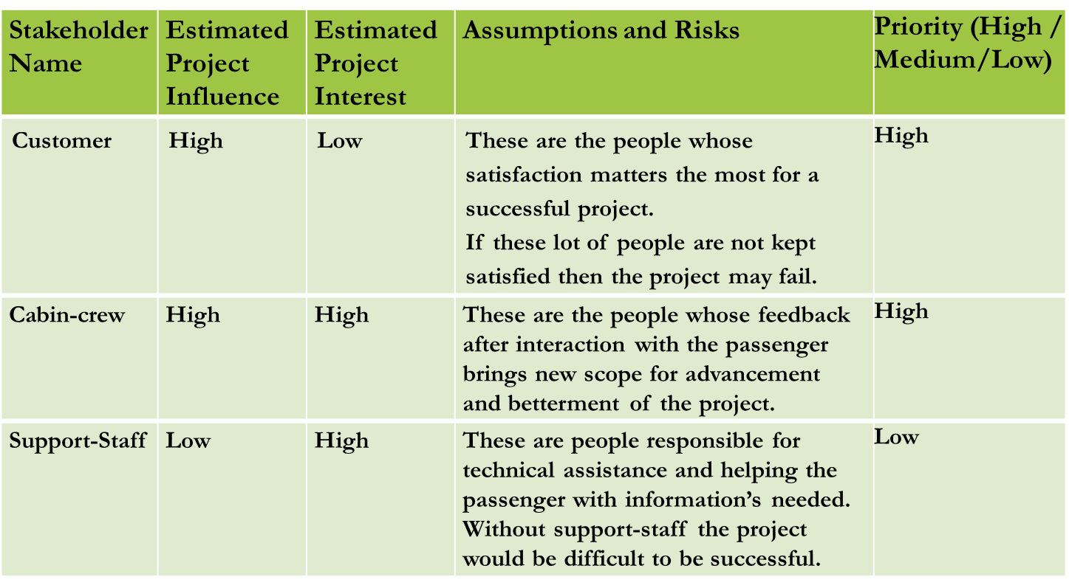
Interest and Influence matrix (continuation)

Slide 27
Communication Plan for Stakeholders
In addition, a clear strategy is vital to identifying and resolving problems before they become significant issues, and for keeping project stakeholders in the project loop.
A communication objective will be set before every meeting
Defining and prioritising our key stakeholders
Developing communication tactics for each stakeholder group
Allocating budget and responsibilities
Developing a quarterly communication calendar
Accessing results and adapting the plan

Slide 28
Communication Plan for Stakeholders (Continuation)
Example:
Walk through of progress to High Interest and High Influence stakeholders
Providing single page dashboard and communicate via meetings
Weekly report for High Interest and Low Influence
RESULT:
Thus the Project Methodology was identified stakeholders were described.

Slide 29
Project Scope and Requirements Management

Slide 30
Executive summary
This system incorporates the use of registration module, passenger and administrator module in an airline.
Using the registration and administrator module, the passenger is logged into the system and all details of available flights will be displayed and the passenger will reserve a flight seat desire location, departure time and arrival time using the passenger module. After the flight confirmation is done the passengers will receive a confirmation after the payment is done.
In administrator module modification on flights, cancellation and addition of flights can be done. The features and documentation will be within the bound of these modules mentioned which provides the clear scope of this project.

Slide 31
PROJECT SCOPE
The different activities of online Airline Reservation System in different phases as per our incremental model includes the following functions:
Establish a secure connection
Login to the system
Search for available flights
Create reservation
View reservation
Cancel reservation
Accepting payment.
The ability of the software is to provide the details of the flights available and allow the customers to choose a particular destination and make a reservation.

Slide 32
IN SCOPE & OUT SCOPE ACTIVITIES
S.No | Activities In Scope | Activities Out of Scope
1 | Account creation of new passenger | Building new company specific software’s
2 | Login to the system | Automatically selecting ads that fit the visitor's interests
3 | Displaying of flight and seat availability | Tracking all user activity on the database and producing custom reports
4 | Creation, viewing and cancellation of reservation.
5 | Accepting payment
6 | Displaying advertisements to visitors

Slide 33
EPICS [MAJOR FUNCTION]
Epic (#) | Epic Description
E1 | Registration Module
E2 | Administrator Module
E3 | Passenger Module
E4 | Payment accepting Module

Slide 34
FUNCTIONAL REQUIREMENTS
Requirement (#) | Requirement Specification | Department | Name of Business User | Status
E1FR1 | As a passenger, login to the system if exists or create an account. | Development | Amit Srivastav | Pending
E2FR1 | Maintaining of airline schedule, fair, timings. | Database Manager | Aman Kalla | Pending
E2FR2 | Viewing the passenger list and available seats | Database Manager | Aman Kalla | Pending
E3FR1 | Book a flight after selecting the source and destination and the feasible flight for the passenger. | Development | Amit Srivastav | Pending
E3FR2 | View the reservation or cancel the reservation | Technical | Roshan Singh | Pending
E4FR1 | Passenger pays for the reservation made. | Financial | Roshan Singh | Pending

Slide 35
NON-FUNCTIONAL REQUIREMENTS
Requirement (#) | Category of NFR | Requirement Specification | Department | Name of Business User | Status
NFR1 | Performance | All pages should load within 3 seconds | Server | Technical Team: Amit Srivastav Roshan Singh Aman Kalla | Pending
NFR2 | Performance | Search should bring the results less than 7 seconds | Server | Technical Team: Amit Srivastav Roshan Singh Aman Kalla | Pending
NFR3 | Availability | Application should be available for 24x7 | Server | Technical Team: Roshan Singh | Pending
NFR4 | Scalability | Registration Service should scale to serve 1000 request per second over 5 minutes timespan | Database | Database Specialist: Aman Kalla | Pending

Slide 36
NON-FUNCTIONAL REQUIREMENTS (CONTINUATION)
Requirement (#) | Category of NFR | Requirement Specification | Department | Name of Business User | Status
NFR5 | Confidentiality | All data should be encrypted. | Database | Database Specialist: Aman Kalla | Pending
NFR6 | Usability | Website should work on all devices | Front-end | Technical Team: Amit Srivastav | Pending
NFR7 | Flexibility | Should be User Friendly | Development | Technical members | Pending
NFR8 | Extensibility | Service should be available to all. | Management | Project Manager | Pending

Slide 37
INFRASTRUCTURE REQUIREMENT
Requirement (#) | Requirement Specification | Department | Name of Business User / Project Team Member | Status
IR1 | Development Machine with 6 GB Ram and 4 Cores | Technical | Amit Srivastav | Pending
IR2 | Code Repository | Technical | Aman Kalla | Pending
IR3 | IDE – Visual Studio and Atom | Development | Roshan Singh | Pending
IR4 | Front end-HTML + CSS + Bootstrap + JavaScript | Development | Amit Srivastav | Pending
IR5 | Back end-RDBMS, Node.js and Java | Development | Aman Kalla | Pending

Slide 38
USER STORY
User Story | Acceptance Criteria | Size of User Story
As customer, I can view all available flights with best price between the selected source and destination | View all flights of that particular day from a selected source and destination. Allow to choose the flights feasible for the passenger. | Medium
As a customer, I want airline reservation to be dynamic such that it can inform the passenger about the change such as rescheduling or cancellation of some flight and must provide alternatives. | Will be able to get the information about any change made due to rescheduling and cancellation of flights. Will provide alternative in case of cancellation. | Big

Slide 39
PROJECT MANAGEMENT PLAN, EFFORT AND COST ESTIMATION AND TEAM FORMATION

Slide 40
EXECUTIVE SUMMARY
In a time when establishing and maintaining a market advantage is crucial, the use of technical innovations such as the Airline Passenger Reservation Systems (APRS) becomes a competitive necessity.
Good business strategies in developing strategic alliances and exposing the consumer to a globally expanded product base allows airlines to compete. A wider range of products, the ability to be flexible with fluctuating consumer needs are all potentially exploitable through the power of technology and strategic planning.
The following report provides an understanding concerning the Airline Passenger Reservation System. It will briefly discuss the advantages associated with integrating the system across the airline industry and what are the project management plan, cost estimate and effort put into the project, infrastructure requirement and project team formation.

Slide 41
PROJECT MANAGEMENT PLAN
The objective of our project is to design and develop a software which would automate the major airline operations. It would be providing the facilities for the reservation of online air tickets or any other operations through an effective and yet simple GUI for a normal passenger intending to travel through airways.
The main purpose of this software is to reduce the manual errors involved in the airline reservation process and make it convenient for the customers to book the flights as when they require such that they can utilize this software to make reservations, modify reservations or cancel a particular reservation.
This system provides a facility to easy access towards a customer and a real time user. They can be easily connected through it in just few steps. There is no requirement for any type of Agent. 24/7 booking available for customers.

Slide 42
PROJECT MANAGEMENT PLAN (CONTINUATION)
The methodology used is incremental as our project delivers model with incorporated added functionality at each incremental stage.
The system developed is technically feasible as all technical requirements are available.
Since the project development is done keeping in mind the user requirements hence it is operationally feasible.
For economic feasibility, the success of the project is judged by the stakeholders depends on the efficient airline operation with maximum passengers, passengers opting for food and stay at the sponsored resort thereby maximising the profit of the organisation and thereby contributing toward the growth of the sponsored brand determines the success of the project.

Slide 43
PROJECT MANAGEMENT PLAN (CONTINUATION)
Moreover, the website would contain the advertisement of the sponsored brand, Sarovar Hotel and resort and would provide coupons to its travellers which would provide them rebate for their stay and food in the resort. The sponsored brands even have the logo of the airline company as a part of advertisement of Indigo Airlines. The count of coupon is maintained which helps in knowing how many times the coupon is used.
For the success of the project for the key stakeholders i.e., the passenger- the airline offers business as well as economy class as two different classes with varying price range, where middle seats cost less when booked first and the window side seats cost more. Moreover at varying times to attract passengers airline offers relatively cheap flights

Slide 44
PROJECT MANAGEMENT PLAN (CONTINUATION)
The active participation of employee in the project also leads to the success of the project as they are the one who works for attaining the objectives of the organisation thereby helping in the process of maximising profits. The project would turn out to be economically feasible it the expenses exceeds the cost.

Slide 45
EFFORT AND COST ESTIMATION
WBS | Activity | Activity Description | Sub-Task | Sub-Task Description | Effort (in hours) | Cost in INR
E1FR1 | E1R1A1 | Design the user screen | E1R1A1T1 | Log into the system for existing users | 3 | 1500
 |  |  | E1R1A1T2 | Register new user | 4 | 2000
E2FR1 | E2R1A1 | Displaying the available flights | E2R1A1T1 | Flights are displayed with timings and fair | 4 | 20002
E2FR2 | E2R2A1 | Display the available seat and passenger list. | E2R2A1T1 | Passenger list is displayed | 4 | 2000
 |  |  | E2R2A1T2 | Seats which have been occupied and are yet to be occupied are listed. | 3 | 1500

Slide 46
EFFORT AND COST ESTIMATION (continuation)
WBS | Activity | Activity Description | Sub-Task | Sub-Task Description | Effort (in hours) | Cost in INR
E3FR1 | E3R1A1 | Displaying of the flights of a particular route. | E3R1A1T1 | Flights with specified source and destination are displayed. | 3 | 1500
E3FR2 | E3R2A1 | Status of reservation is displayed | E3R2A1T1 | If the reservation exists show the details of the reservation or display that the reservation has been cancelled. | 4 | 2000
E4FR1 | E4R1A1 | Accepting of payment | E4R1A1T1 | Payment for the reservation made by the passenger is stored in the database. | 3 | 1500

Slide 47
INFRASTRUCTURE/COST ESTIMATION
Infrastructure Requirement | Qty | Cost per qty(INR) | Cost per item(INR)
IR1 | 3 | 50,000 | 50,000
IR2 | 3 | 4500 | 4500
IR3 | 3 | 8000 | 8000
IR4 | 4 | 5000 | 5000
IR5 | 3 | 4000 | 4000

Slide 48
Maintenance and support cost
Category | Details | Qty | Cost per qty per annum | Cost per item
People | Network, System, Middleware and DB admin Developer , Support Consultant | 3 | 2,000,000 | 6,000,000
License | Operating System Database Middleware IDE | 10 | 10000 | 100,000
Infrastructures | Server, Storage and Network | 20 | 20000 | 400,000

Slide 49
IDENTIFICATION TEAM MEMBERS
Name | Role | Responsibilities
Amit Srivastav | Key Business User (Product Owner) | Provide clear business and user requirements
Aman Kalla | Project Manager | Manage the project
Roshan Singh | Business Analyst | Discuss and Document Requirements
Amit Srivastav | Technical Lead | Design the end-to-end architecture
Aman Kalla | UX Designer | Design the user experience
Amit Srivastav | Frontend Developer | Develop user interface
Aman Kalla | Backend Developer | Design, Develop and Unit Test Services/API/DB
Roshan Singh | Cloud Architect | Design the cost effective, highly available and scalable architecture
Roshan Singh | Cloud Operations | Provision required Services
Amit Srivastav | Tester | Define Test Cases and Perform Testing

Slide 50
RESPONSIBILITY ASSIGNMENT MATRIX
RACI Matrix | Team Members
Activity | Name (BA) | Name (Developer) | Name (Project Manager) | Key Business User
User Requirement Documentation | Amit Srivastav | Amit Srivastav Aman Kalla Roshan Singh | Aman Kalla | Passenger Sponsor Indigo Airline Corporation.
Discuss and Documents Requirement | Roshan Singh | Amit Srivastav Aman Kalla Roshan Singh | Aman Kalla | Passenger Sponsor Indigo Airline Corporation.
Design of the end-to-end architecture. | Amit Srivastav | Amit Srivastav Aman Kalla Roshan Singh | Aman Kalla | Passenger Sponsor Indigo Airline Corporation.

Slide 51
RESPONSIBILITY ASSIGNMENT MATRIX (CONTINUATION)
RACI Matrix | Team Members
Activity | Name (BA) | Name (Developer) | Name (Project Manager) | Key Business User
Development of the user interface | Amit Srivastav | Amit Srivastav Aman Kalla Roshan Singh | Aman Kalla | Passenger Sponsor Indigo Airline Corporation.
Design, Development and database management. | Aman Kalla | Amit Srivastav Aman Kalla Roshan Singh | Aman Kalla | Passenger Sponsor Indigo Airline Corporation.
Management of the storage and cloud operations. | Roshan Singh | Amit Srivastav Aman Kalla Roshan Singh | Aman Kalla | Passenger Sponsor Indigo Airline Corporation.
Testing | Amit Srivastav | Amit Srivastav Aman Kalla Roshan Singh | Aman Kalla | Passenger Sponsor Indigo Airline Corporation.

Slide 52
WORK BREAKDOWN STRUCTURE, RISK MANAGEMENT AND PLAN

Slide 53
Executive Summary
The planning phase of the project has come to an end and identifying the risks involved in our project and ways to manage them are discussed among the team members.
The airline reservation project implementation has been planned to start on 12th March,2021 and is expected to be completed by 20th May,2021.
The risks identified are some of technical nature while some of business and includes loss of faith and support of sponsors, data management risk leading to displaying of incorrect information of the flight details, as well as managing the passenger data and even the issues pertaining to breaching of data leading to loss of the company and benefit of the competitors.
The risks are managed by encouraging stakeholders communication, integrating risks during the course of planning and mitigating risk by providing data encryption, gaining the support of sponsors and incorporating the skills and experience of the staff and team members.

Slide 54
WBS With Project Schedule
Module (#) | Activity (#) | Sub-Task(#) | Assignee(s) | Planned Start Date | Planned End Date | Actual Start Date | Actual End Date | Status
Registration | Log in/sign up page creation | Creating an account for the new user and allowing log in for existing user. | Amit Srivastav Roshan Singh Aman Kalla | 12.03.2021 | 26.03.2021 | ---- | ---- | Pending
Administrator | Displaying the available flights, seat and passenger list. | Flights and passenger list is displayed. | Amit Srivastav Roshan Singh Aman Kalla | 27.03.2021 | 14.04.2021 | ---- | ---- | Pending

Slide 55
WBS With Project Schedule
Module (#) | Activity (#) | Sub-Task(#) | Assignee(s) | Planned Start Date | Planned End Date | Actual Start Date | Actual End Date | Status
Passenger | Displaying of the flights of a particular route. Status of reservation is displayed. | Flights with specified source and destination are displayed. If the reservation exists shows the details of the reservation or display that the reservation has been cancelled. | Amit Srivastav Roshan Singh Aman Kalla | 15.04.2021 | 30.04.2021 | ---- | ---- | Pending
Payment | Accepting of payment. | Payment for the reservation made by the passenger is stored in the database. | Amit Srivastav Roshan Singh Aman Kalla | 1.05.2021 | 12.05.2021 | ---- | ---- | Pending

Slide 56
Risk Identification
Risk ID (#) | Risk Description | Impact Description
R01 | Maintaining and managing data is costly and tedious. | In case of any manual error the debugging is too time-consuming due to management of huge data and managing data can also lead to an increase in the expense of the budget of the software project.
R02 | Security issues like leaking of data and corruption of database. | Can benefit the competitors and can bring heavy loss to the airlines company and ultimately the failure of the project.
R03 | Losing the support of the existing sponsors. | Can bring a heavy impact on the budget of the project and can bring down the quality of the software produce.
R04 | Insufficient data due to loss of data or due to some manual errors. | It will lead to passing up of wrong information to the customers and failure of the database management system.

Slide 57
Managing RISK
Risk ID (#) | Status [Open / Closed] | Risk Appetite [ Accept/ Mitigate/ Transfer/Avoid] | Action | Action Owner | Target Date | Remarks
R01 | Open | Accept | Accept | Amit Srivastav Aman Kalla | 13.05.2021 | Risk is taken under action.
R02 | Open | Mitigate | Provide data encryption. | Aman Kalla Roshan Singh | 18.05.2021 | Risk is taken under action.
R03 | Open | Transfer | Gain support of other sponsors. | Roshan Singh | 20.05.2021 | Risk is taken under action.
R04 | Open | Mitigate | Data management is performed and tested at each phase after implementation. | Amit Srivastav Roshan Singh Aman Kalla | 10.05.2021 | Risk is taken under action.

Slide 58
ARCHITECTURE DIAGRAM

Slide 59
SYSTEM ARCHITECTURE

Slide 60
SYSTEM ARCHITECTURE (CONTINUED)

Slide 61
SYSTEM ARCHITECTURE (CONTINUED)

Slide 62
SYSTEM ARCHITECTURE (CONTINUED)

Slide 63
SYSTEM ARCHITECTURE (CONTINUED)

Slide 64
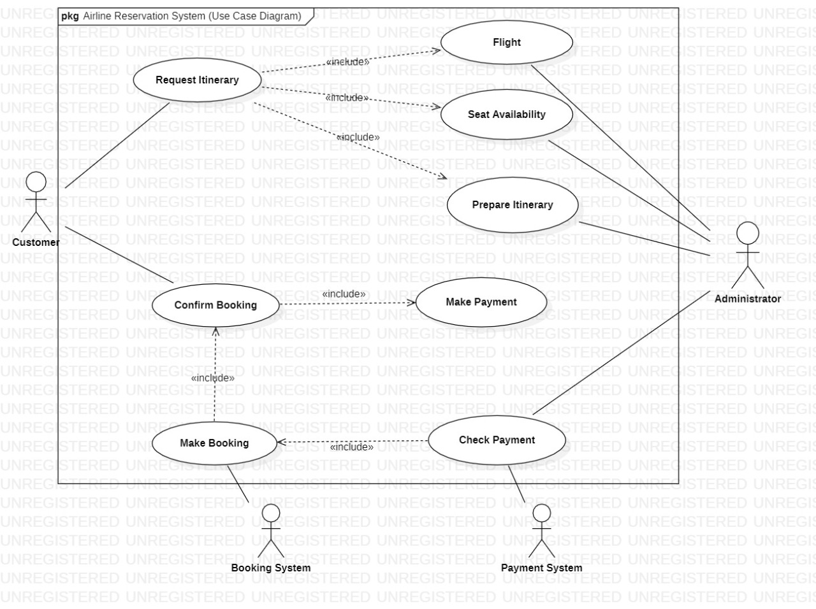
Use-case diagram

Slide 65
DESCRIPTION
The above use case diagram depicts all the functions or activities that a user or a customer can perform on the application and also about the roles of the administrator. They can be discussed in detail as follows:
Login and Register: The Airline Reservation System also comes with the customer registration details page, where the customer can enter his details and register. He can also create a username and password. The administrator has to login first in order to be able to make changes to the Airline Reservation System, by adding, deleting or modifying the data in the Airline Reservation System database. After making the necessary changes, he then has to logout of the system, in order to prevent misuse of the data.

Slide 66
DESCRIPTION(CONTINUED)
Add/Modify Customer Information: Daily the Airline Reservation System will have many customers registering with the website and many of them unsubscribing. Only the administrator will have the sole rights to modify the database accordingly.
Add/Modify Flight Information: The Administrator also has the sole rights to add, delete or modify the flight information. Sometimes, flights get cancelled for some reason, so such flights would be removed from the list of flights available to the customer. Similarly whenever any flight information has to be modified or if any new flights need to be added to the database, these operations are performed by the administrator.
Cancellation of Reservations: Sometimes, after making a reservation, a customer might cancel the reservation he has made. So, the administrator also handles such special situations and sends the customer an e-mail confirmation after deleting the specific transaction.

Slide 67
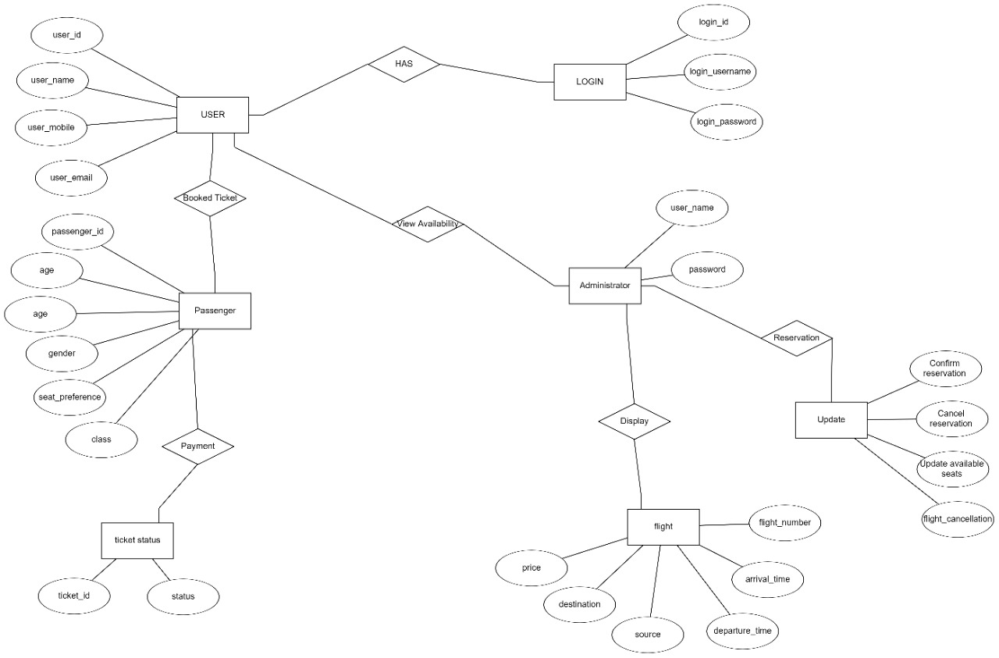
ER DIAGRAM

Slide 68
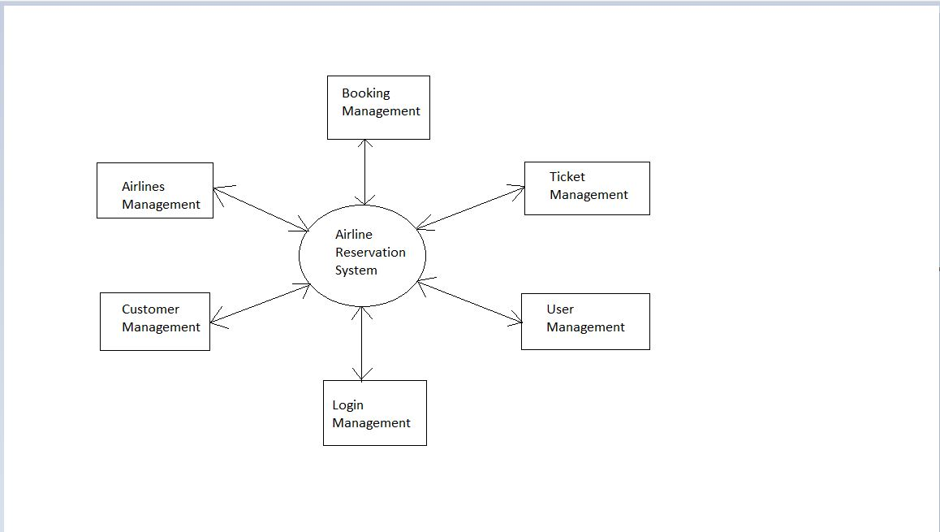
DFD Diagram (ZERO-LEVEL process)

Slide 69
ZERO-LEVEL PROCESS DESCRIPTION
This is the zero level DFD of ARS where we have elaborated the process of our Airline Reservation System.
It outlines the modules used in our project.
The processes are:
User management
Airlines management
Ticket management
Login management
Booking management
Customer management

Slide 70
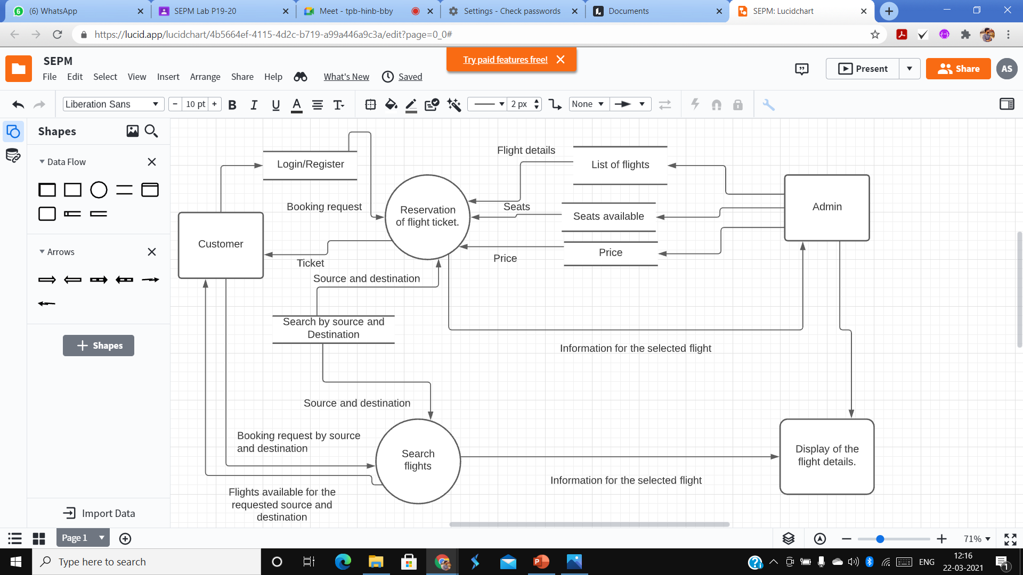
DFD Diagram (FIRST-LEVEL process)

Slide 71
DFD Diagram (FIRST-LEVEL process)
This is the first level DFD of ARS where we have elaborated the main functionality or subprocess of our Airline Reservation System.
It identifies the data stores such as flight details, price and available seats as per the requested source and destination and the booking request made by the external entity i.e. the customer and passing the output to the external entity by displaying the list of available flights.
The process includes:
Booking request made by the customer
Displaying of the flights available according to the source and destination.
Displaying of the price and seats available.
Providing the ticket id to the customer for successful booking request.

Slide 72
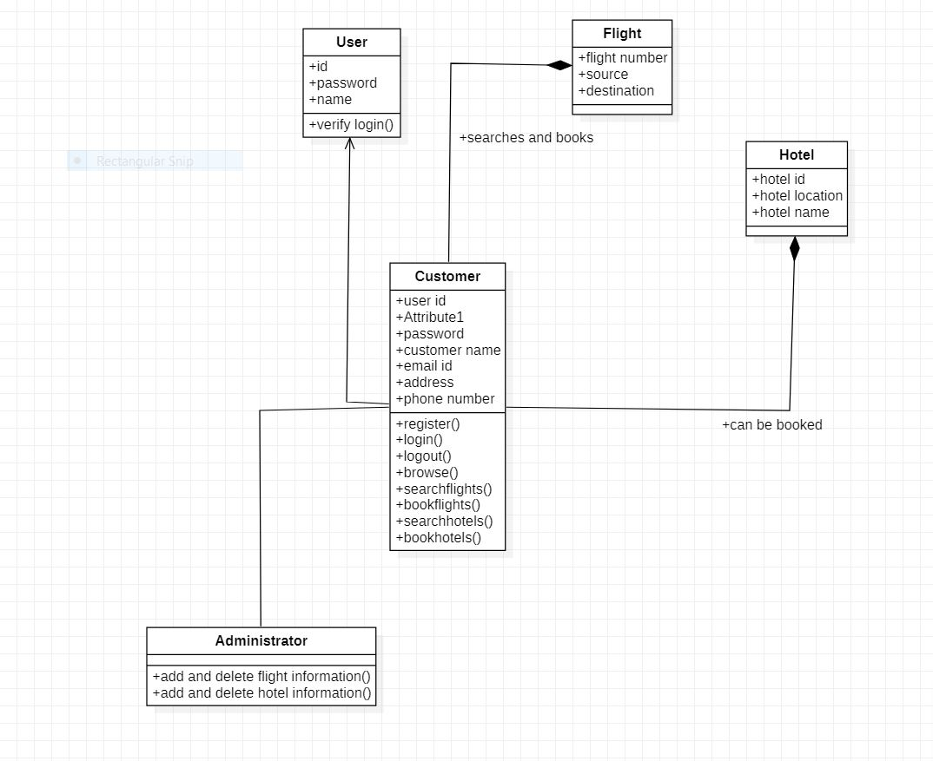
Class Diagram

Slide 73
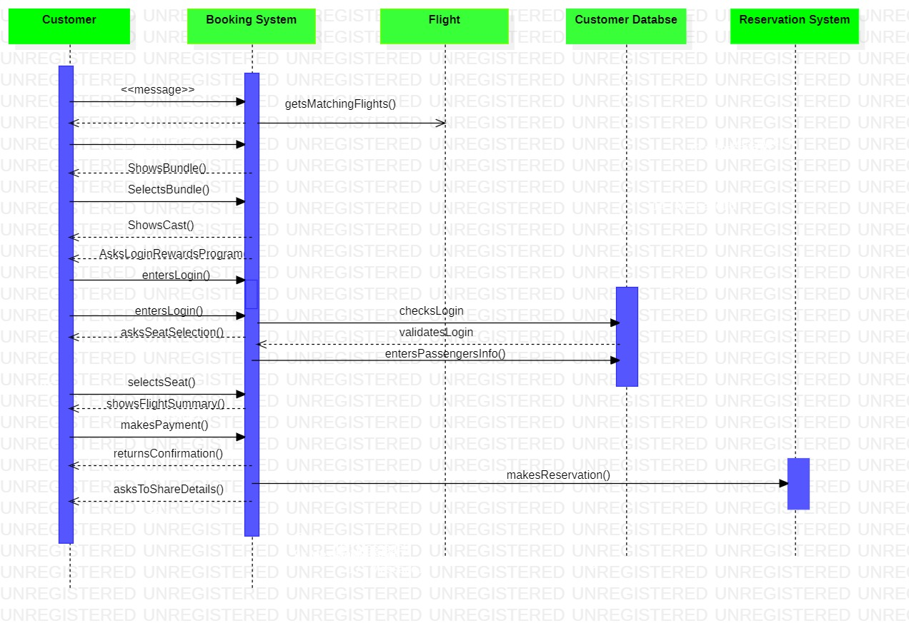
SEQUENCE DIAGRAM

Slide 74
ARCHITECTURE DIAGRAM WITH DESCRIPTION

Slide 75
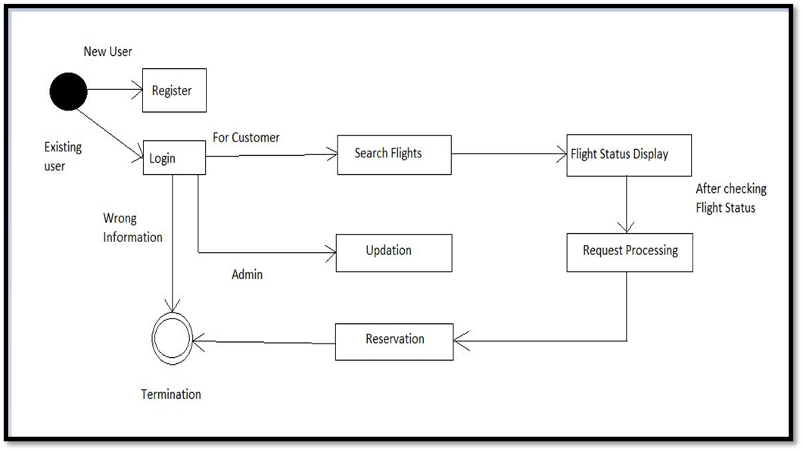
State diagram

Slide 76
STATE DIAGRAM (DESCRIPTION)
The above state diagram depicts the flow from one level to another starting from the user enrolling or getting themselves logged into to the application.
In case of wrong login credentials, the process of logging in to the system terminates otherwise the services of the system can be availed by the user.
The user can search for flights and the flights search results are displayed by the admin module through the database as per the search crtiteria.
Then the user books the ticket and the payment is made.
Finally, the entire process terminates with successful reservation.

Slide 77
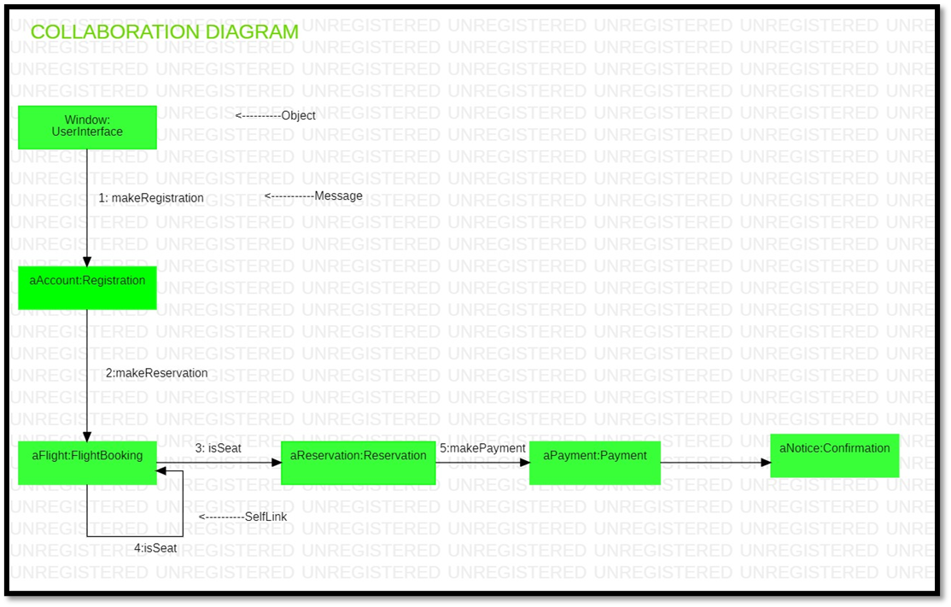
COLLABORATION DIAGRAM

Slide 78
COLLABORATION DIAGRAM (DESCRIPTION)
The above collaboration diagram depicts the sequence in which how the different objects of our project interact to perform the needed functionality of an Airline Reservation System.
The user interface allows our object i.e., the user module to allow the user to interact via registration or enrollment which is then followed by flight booking and a self-message which checks the availability of the seat and perform the further confirmation of the reservation which is then completed by payment done by the user and a confirmation of the information passed.

Slide 79
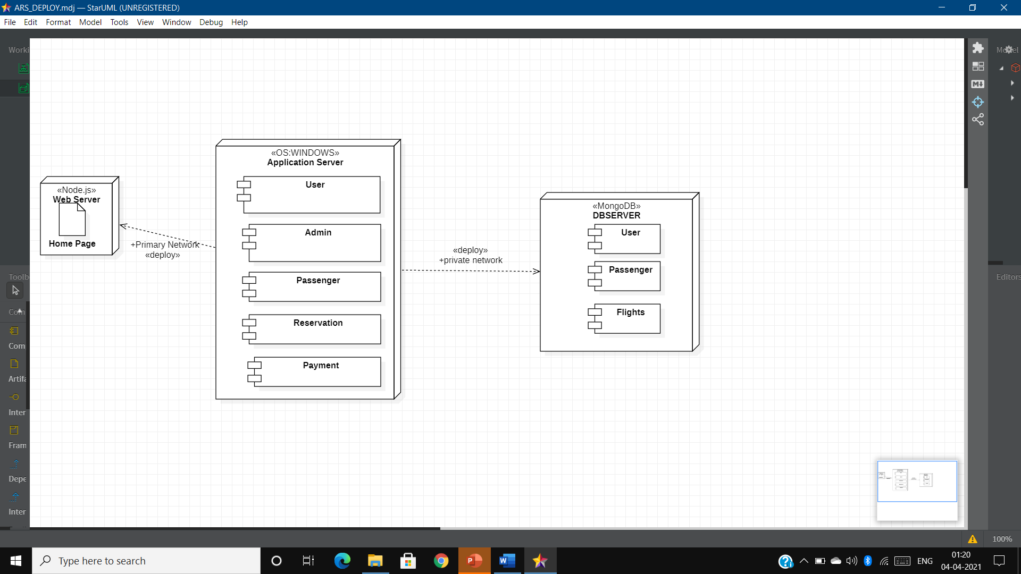
DEPLOYEMENT DIAGRAM

Slide 80
DEPLOYEMENT DIAGRAM (DESCRIPTION)
The above deployment diagram depicts the description of the web server, database server and the OS used for deploying our website.
The web server used for hosting our website would be done using the local host as well as would be serviceable for other hosts using the Heroku deploy center and node.js.
The application server which contains all the information and code snippets for the user module passenger module, admin system, payment module and reservation module uses Windows as the operating system.
The database for our web is deployed on the server using MongoDB and node.js which contains all the details of the user, the passenger and the flight details.

Slide 81
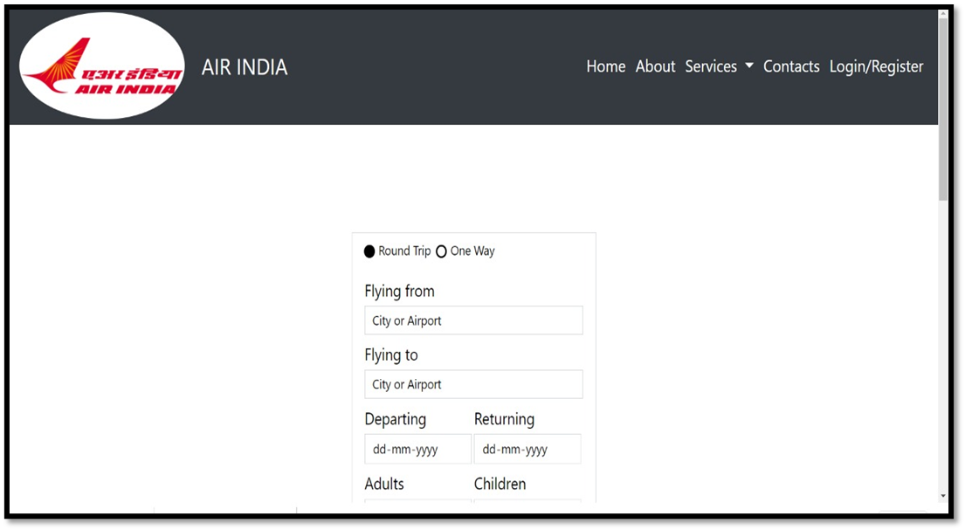
SAMPLE FRONT END DESIGNS

Slide 82
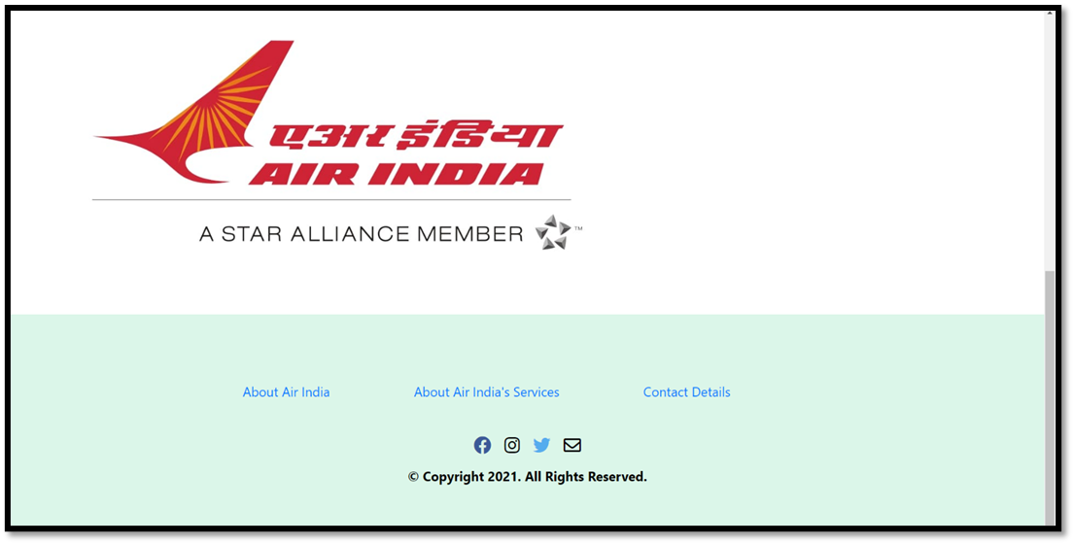
SAMPLE FRONT END DESIGNS (CONTINUED)

Slide 83
MODULE I DESCRIPTION AND IMPLEMENTATION

Slide 84
DESCRIPTION
The module 1 of our project titled “Airline Reservation System” deals with the registration/login process of the system.
For a new user, the sign-up option is available for getting him/her enrolled as a user and the details entered by the user in the registration form gets stored in the database.
For an existing user login option ensures him/her getting logged in to the system after authenticating the credentials by looking into the user database and if the specified user exists then a success message is displayed and redirects it to the user account otherwise it displays an error message.

Slide 85
SOURCE CODE
<div class="content" style="margin-top: 50px";>
<div class="text">Login Form</div>
<form action="#">
<div class="field">
<span class="fas fa-user"></span>
<input type="text" placeholder="Email or Phone" required>
</div>
<div class="field">
<span class="fas fa-lock"></span>
<input type="password" placeholder="Password" required>
</div>
<div class="forgot-pass">
<a href="#">Forget Password</a>
</div>
<button>Sign in</button>
<div class="signup">New User-Register <a href="register.html">Sign Up</a></div>
</form>
</div>

Slide 86
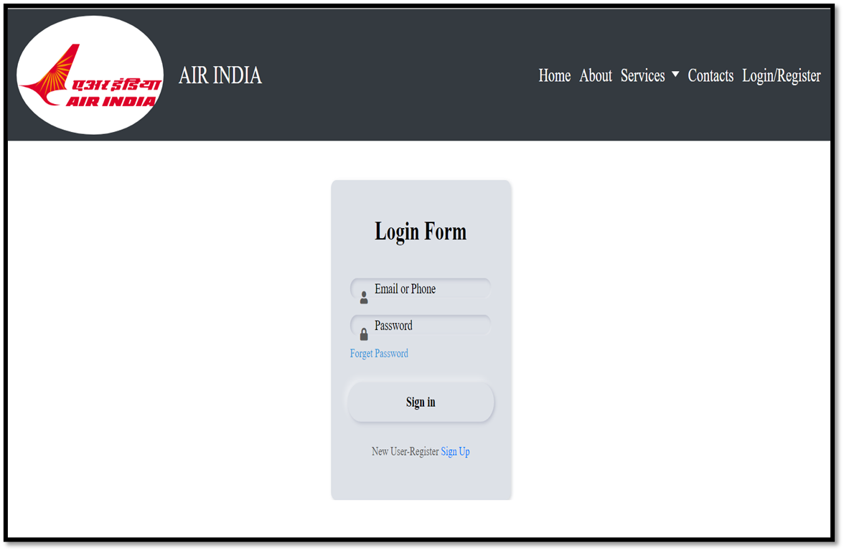
RESULT

Slide 87
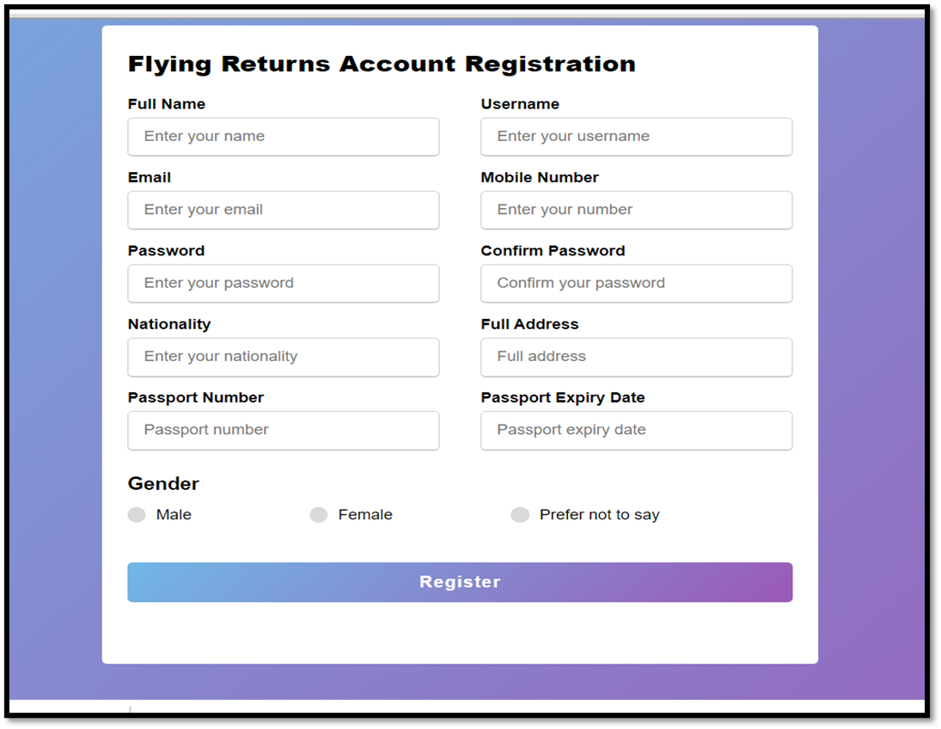
RESULT

Slide 88
MODULE II DESCRIPTION AND IMPLEMENTATION

Slide 89
DESCRIPTION
The module 2 of our project titled “Airline Reservation System” deals with the authentication of the login process into the system for the admin.
While registering a new user, the details entered by the user in the registration form gets stored in the database which can be viewed by the admin under the user section of the admin page.
The admin can add the flights into the databse as well as remove the flights from the database using manage flight option available under flight schedule dropdown.

Slide 90
SOURCE CODE
<table class="table table-striped table-hover">
<thead> <tr>
<th>#</th> <th>ID</th>
<th>FirstName</th> <th>LastName</th>
<th>Phone</th> <th>Email</th>
</tr>
</thead>
<tbody>
<% for(var i=0;i<a.length;i++){ %>
<tr>
<td><%=i+1%></td>
<td><%=a[i]._id%></td>
<td><%=a[i].Firstname%></td>
<td><%=a[i].Lastname%></td>
<td><%=a[i].Phonenumber%></td>
<td><%=a[i].username%></td>
</tr>
<%}%>
</tbody>
</table>

Slide 91
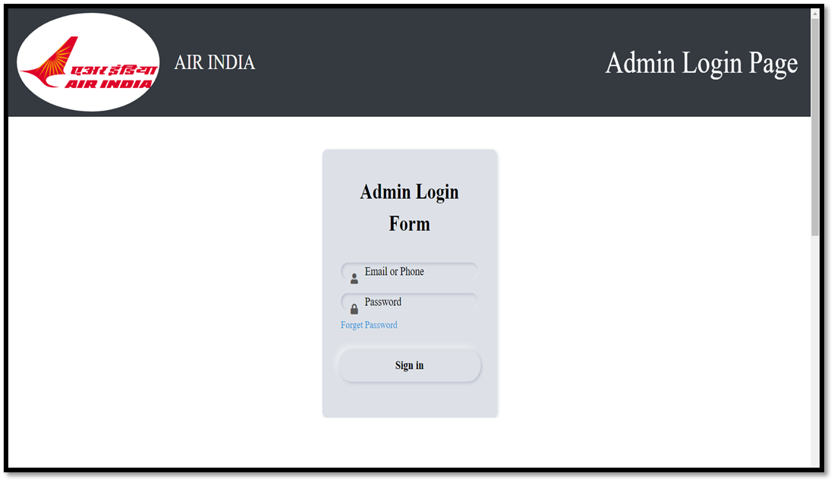
RESULT

Slide 92
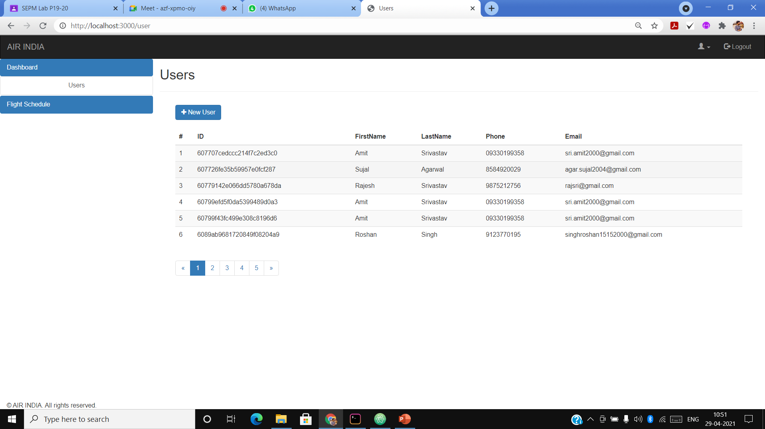
RESULT (CONTINUED)

Slide 93
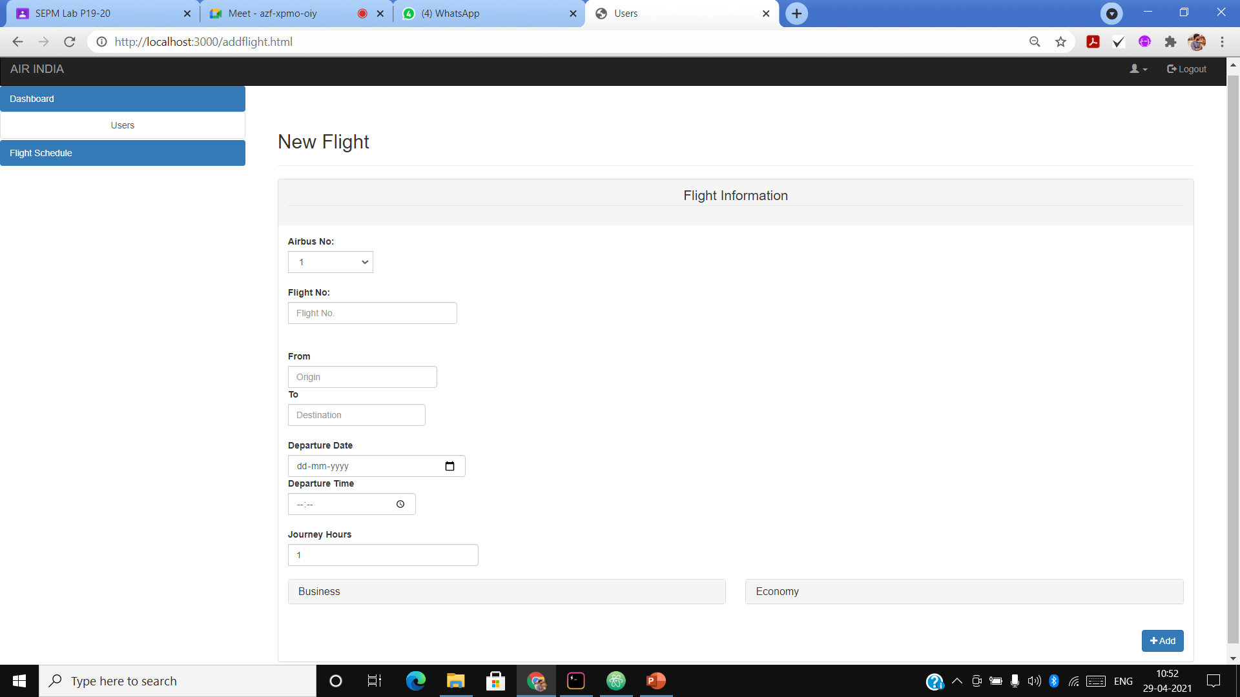
RESULT (CONTINUED)

Slide 94
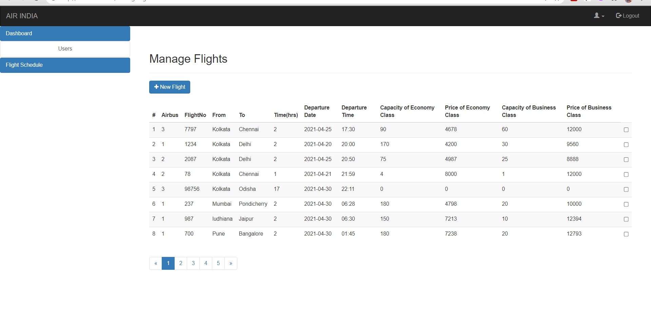
RESULT (CONTINUED)

Slide 95
MODULE III DESCRIPTION AND IMPLEMENTATION

Slide 96
DESCRIPTION
The module 3 of our project titled “Airline Reservation System” is the passenger module.
It deals with the displaying of the available flights as per the source and destination entered by the user.
It displays the price of the flights as per the class, i.e. Economy or Business class, selected by the user.
The book now button directs the passenger to the payment gateway.

Slide 97
SOURCE CODE
<% for(var i=0;i<flightDb.length;i++){ %>
<div class="row" style="border: 1px solid;">
<div class="col">
<img src="images/AILOGO.jpg" alt="" height="60" width="60">
AI <%=flightDb[i].flightNumber%>
</div>
<div class="col">
<%=flightDb[i].dt%>
</div>
<div class="col">
<%=flightDb[i].Journey%>
</div>
<% if(am.tc==='1'){ %>
<div class="col">
₹<%=flightDb[i].pe%> (E)
</div>
<% } %>

Slide 98
SOURCE CODE (CONTINUATION)
<% if(am.tc==='2'){ %>
<div class="col">
₹<%=flightDb[i].pb%> (B)
</div>
<% } %>
<div class="col" id="butt">
<button type="button" id="myBtn" name="button" class="BUTTON_MYG" value="<%=i+1%>"><a href="https://rzp.io/l/i9wwwBj" style="color: white; text-decoration: none;">Book Now</a></button>
</div>
</div>
<% } %>

Slide 99
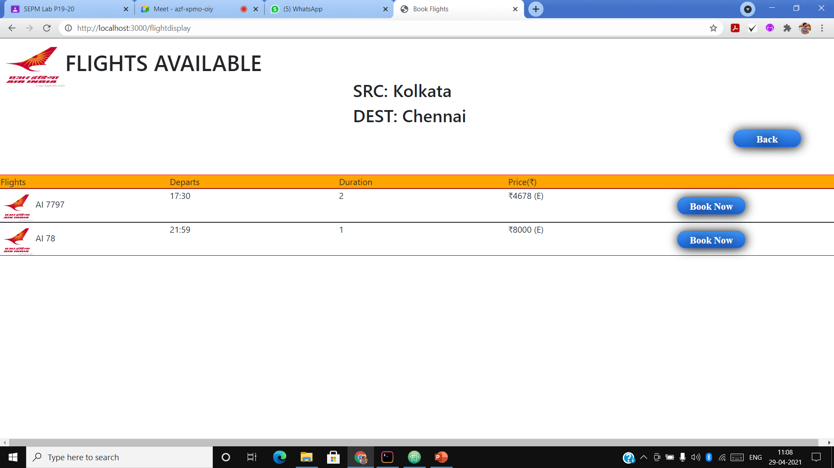
RESULT

Slide 100
MODULE IV DESCRIPTION AND IMPLEMENTATION

Slide 101
DESCRIPTION
The module 4 of our project titled “Airline Reservation System” is the paymentmodule.
When the user clicks on the book now button, it directs him/her to the payment gateway.
The user need to fill in the details and on clicking the pay option the different modes of payement appears.
The user selects the mode of payment and once the payment mode is selected the payment is done successfully and the user receives the payment receipt of the reservation made.

Slide 102
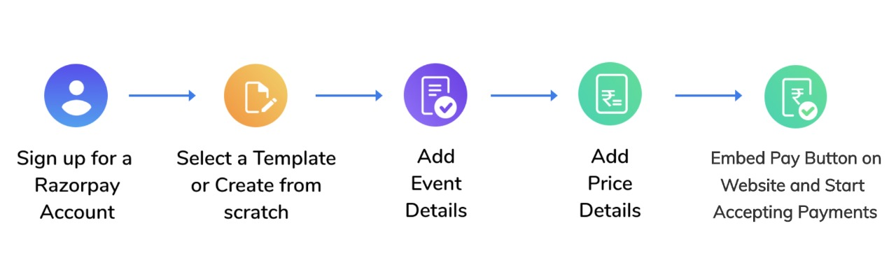
Implementation

Slide 103
SOURCE CODE
var paymentPageData = data.payment_link;
paymentPageData.description = paymentPageData.description ? JSON.parse(paymentPageData.description).value : null;
var requestParams = [];
var templateData = {
key_id: data.key_id,
base_url: data.base_url,
is_test_mode: data.is_test_mode,
merchant: data.merchant,
org: data.org,
payment_page_data: data.payment_link,
context: {
page_title: data.payment_link.title,
form_title: 'Payment Details'
},
requestParams: requestParams,
view_preferences: data.view_preferences};

Slide 104
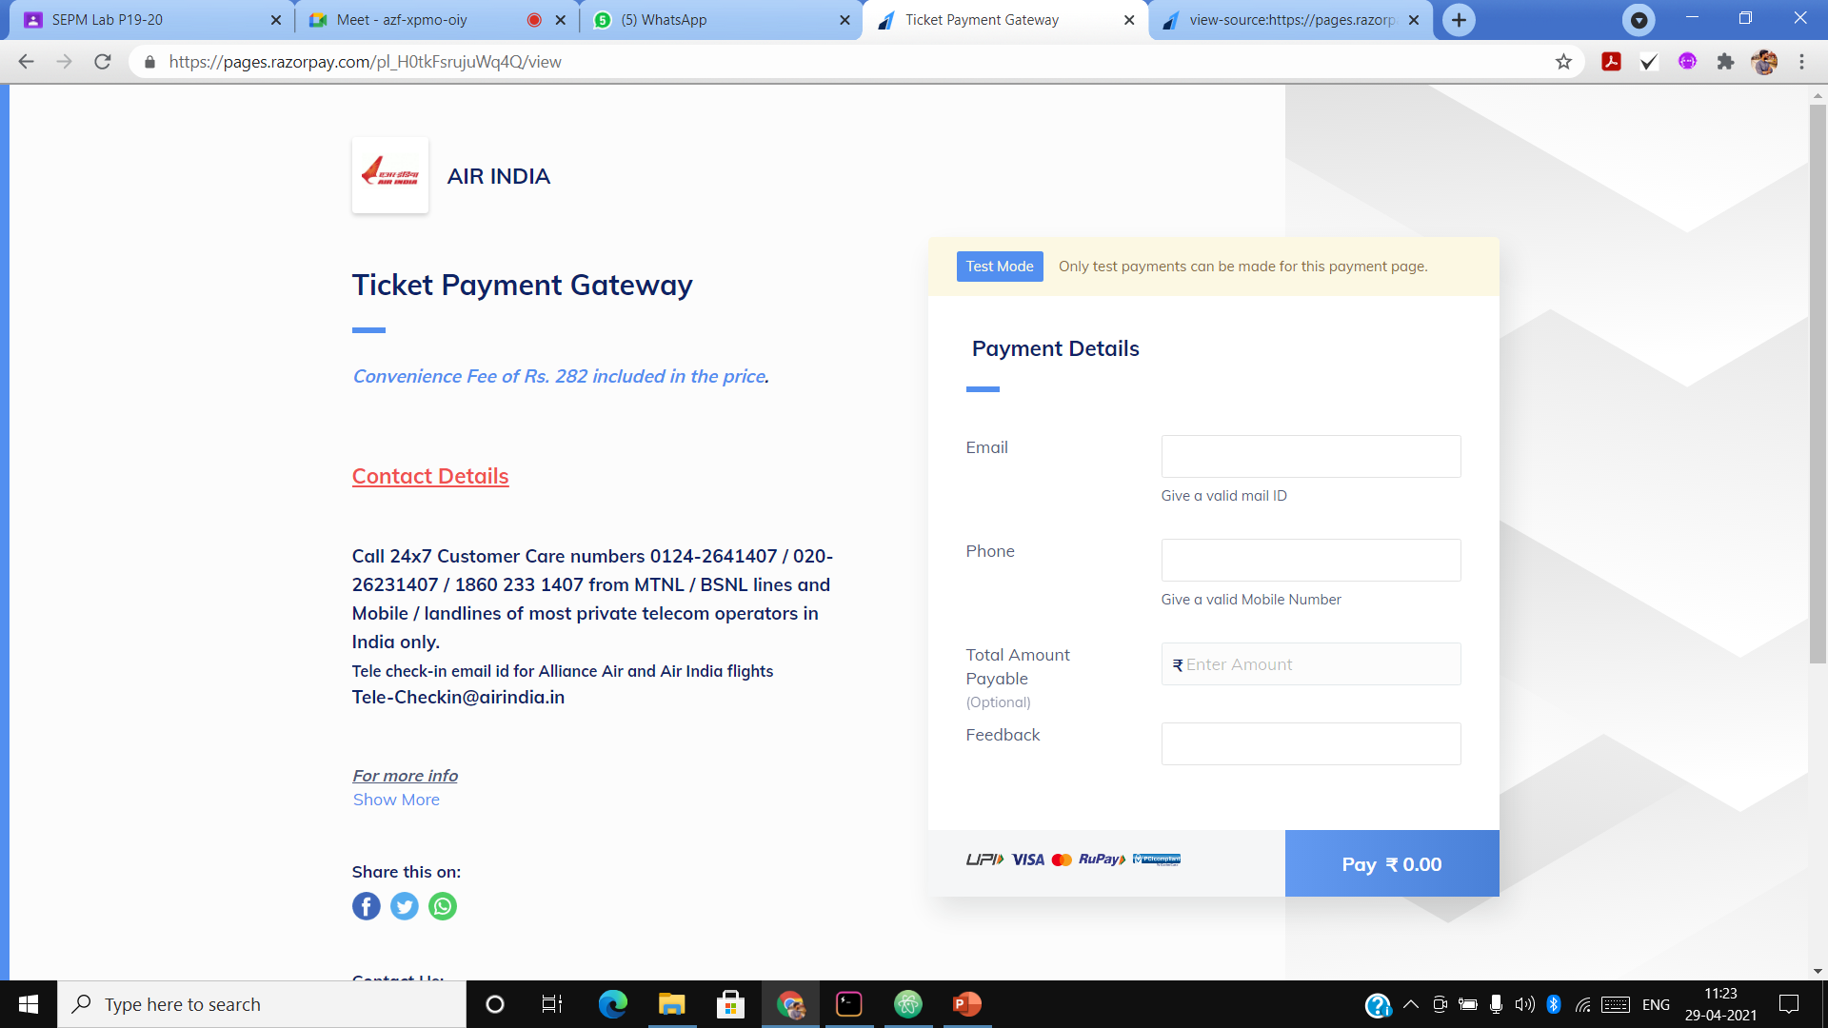
RESULT

Slide 105
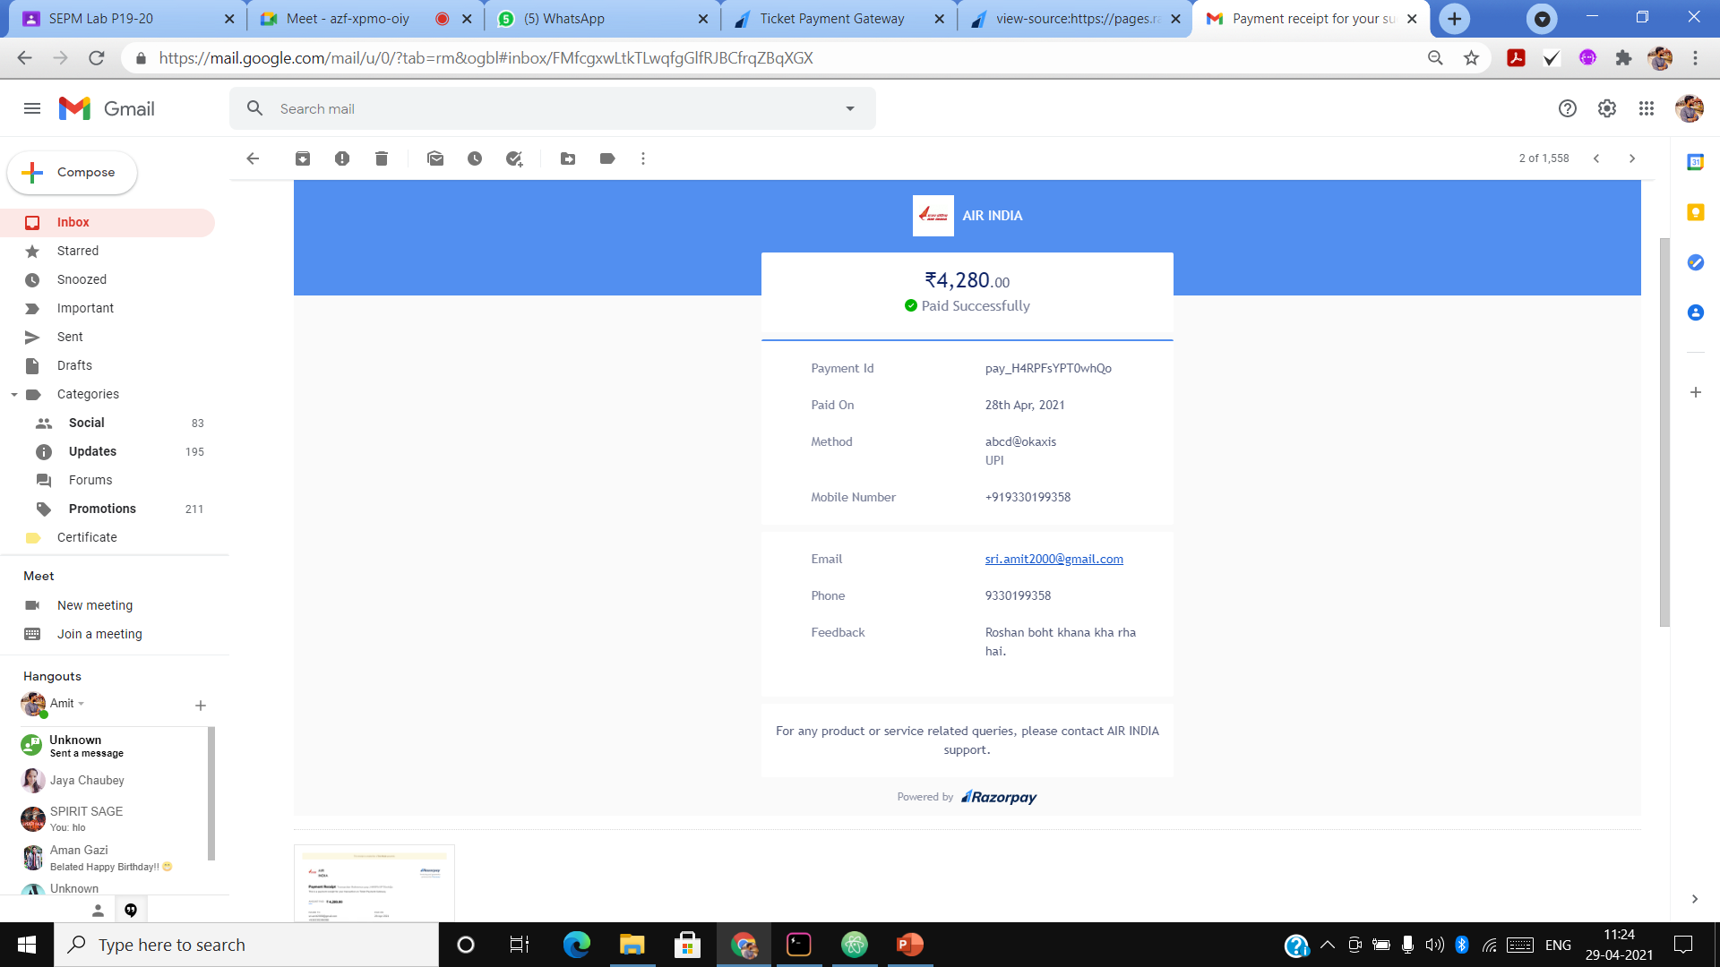
RESULT (CONTINUED)

Slide 106
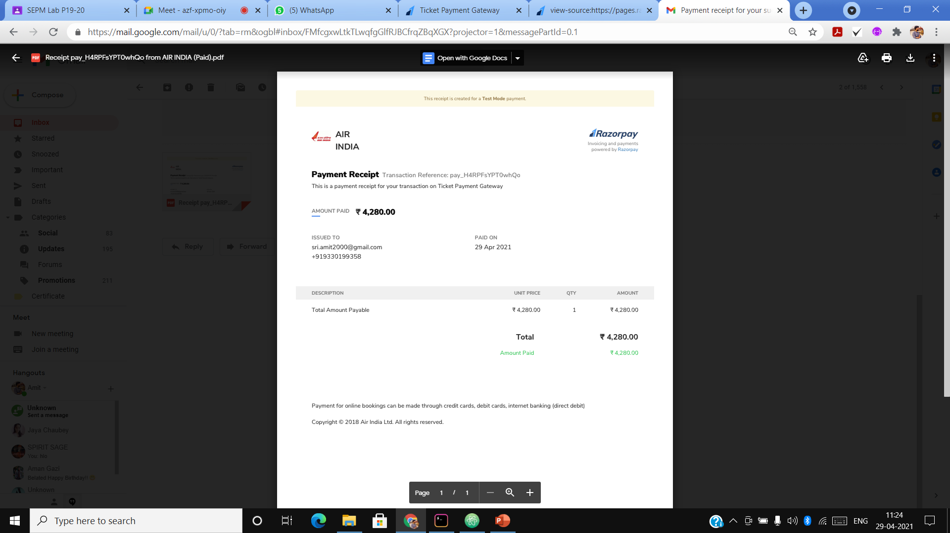
RESULT (CONTINUED)

Slide 107
TEST PLAN AND IMPLEMENTATION

Slide 108
Executive Summary
The main purpose of the test plan for the Airline Reservation System is to discuss the testing details of the use cases of the Airline Reservation System. The software project test plan also describes the objective, scope and approach of the software testing effort for the Airline Reservation System project. The test plan for the Airline Reservation System also indicates the personnel responsible for each task and also specifies the risks associated with the test plan.

Slide 109
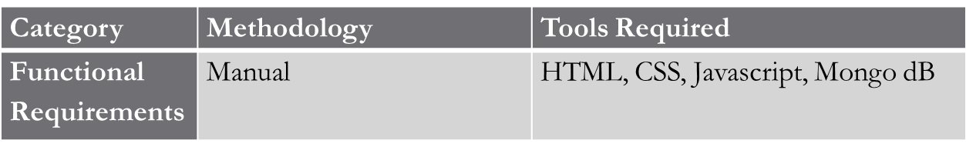
Test Plan
A Test Plan is a detailed document that describes the test strategy, objectives, schedule, estimation, deliverables, and resources required to perform testing for a software product. Test Plan helps us determine the effort needed to validate the quality of the application under test. The test plan serves as a blueprint to conduct software testing activities as a defined process, which is minutely monitored and controlled by the test manager.
Types of Testing , Methodology , Tools:

Slide 110
SCOPE OF TESTING
Functional:
Check and validate email ID and password at the time of login/registration
Check whether data fields are left empty in registration page.
Check whether wrong format entered of not in input fields in registration page.
Incorrect search criteria entered or incorrect format of data entered into the data entry fields of the flight search and booking page.
Non-Functional:
Check the possibility of crashing and feasibility of the software
Test the time for loading of the different pages.

Slide 111
TEST DELIVERABLES
Before Testing
1. Test Plan Document
2. Test Cases
3. Test Design Specifications
During Testing
1. Test Scripts
2. Test Data
3. Error logs and Execution Logs
After Testing
1. Test Report
2. Defect Report
3. Release Report

Slide 112
FUNCTIONAL TEST CASES
Test ID (#) | Test Scenario | Test Case | Execution Steps | Expected Outcome | Actual Outcome | Status | Remarks
1. | USER LOGIN | Check username, which is the email-id in the case of the Airline Reservation System. | User clicks on User Registration link Enter the email ID on Login page Click Login/Register button | A valid e-mail id of the user and a correct password associated with the email-id which he uses to log in. | same | Pass / Failure | success
2. | USER REGISTRATION | Checks for wrong format entered in the input fields for the registration page. | Open the registration window Fill up the credentials Click on submit button | A correct format entered by the customer into the input fields of the registration page. | same | Pass/ Failure | success

Slide 113
FUNCTIONAL TEST CASES(CONTINUED…)
3. | USER REGISTRATION | Check whether the data fields left out empty in the registration page. | Open the registration window Fill up the credentials Click on submit button | The customer would enter the data in all the fields in the registration form. | same | Pass/ Failure | success
4. | SEARCH AND BOOK FLIGHTS | Check the incorrect search criteria entered or incorrect format of data entered into the data entry fields of the flight search and booking page. | Open the book flights window Fill up details as per your choice of booking Click on Search flights | Enter the data into the data entry fields in a correct format. | same | Pass/Failure | success

Slide 114
NON-FUNCTIONAL TEST CASES
Test ID (#) | Test Scenario | Test Case | Execution Steps | Expected Outcome | Actual Outcome | Status | Remarks
1. | Page | Check the loading time of page | Go to different window after execution of previous page/window | Loading of page in 5 seconds | same | Pass/ Failure | success

Slide 115
Defect Log
Requirement # | Defect ID # | Defect Description | Assignee | Status
M1R1 | BTN1 | On searching a Flight’s destination, it shows insufficient data | Amit Srivastav | Success
M1R2 | BTN2 | Login button doesn’t accept the data of some registered data | Roshan Singh | Success

Slide 116
Test Report
The test cases failed were negligible and were checked easily.
Category | Progress Against Plan | Status
Functional Testing | Red | Completed
Non-Functional Testing | Red | Completed
Functional | Test Case Coverage (%) | Status
BTN1 | 100% | Completed
BTN2 | 100% | Completed

Slide 117
THANK YOU

